Slide 1



PROJECT MANAGEMENT IN PRACTICE
Project Quality Management
Lecture No: 10 Week: 5
Vispi Shroff
Sub Heading
And Date

Slide 2

Recap
Leadership Theory
Project Management Skill-Sets

Slide 3
Today’s Topics & Learning Outcomes
Definition of Project Quality Management & its relation to IT Projects
Quality Planning and relationship to scope management
Importance of Quality Assurance
Tools & Techniques for quality control

Slide 4
What is Project Quality?
- The International Organization for Standardization (ISO) defines quality as “the degree to which a set of inherent characteristics fulfils requirements” (ISO9000:2000)
- Other experts define quality based on:
- Conformance to requirements: the project’s processes and products meet written specifications
- Fitness for use: a product can be used as it was intended

Slide 5
What is Project Quality Management?
- Project quality management ensures that the project will satisfy the needs for which it was undertaken
- Processes include:
- Planning quality: identifying which quality standards are relevant to the project and how to satisfy them; a metric is a standard of measurement
- Performing quality assurance: periodically evaluating overall project performance to ensure the project will satisfy the relevant quality standards
- Performing quality control: monitoring specific project results to ensure that they comply with the relevant quality standards

Slide 6
Quality Planning
Implies the ability to anticipate situations and prepare actions to bring about the desired outcome.
One can reduce or prevent defects by
Identifying relevant standards or models and adopting processes and procedures to build quality into the product and the project.
Training and indoctrinating people in quality
Planning a process that ensures an appropriate outcome

Slide 7
Scope of IT Projects and Quality Planning
Certain aspects of the scope/requirements of a project can help identify aspects of a quality plan.
- Functionality is the degree to which a system performs its intended function
- Features are the system’s special characteristics that appeal to users
- System outputs are the screens and reports the system generates
- Performance addresses how well a product or service performs the customer’s intended use
- Reliability is the ability of a product or service to perform as expected under normal conditions
- Maintainability addresses the ease of performing maintenance on a product

Slide 8
Performing Quality Assurance
- Quality assurance includes all the activities related to satisfying the relevant quality standards for a project
- Another goal of quality assurance is continuous quality improvement
- Benchmarking generates ideas for quality improvements by comparing specific project practices or product characteristics to those of other projects or products within or outside the performing organization
- A quality audit is a structured review of specific quality management activities that help identify lessons learned that could improve performance on current or future projects

Slide 9
Quality Control
The main outputs of quality control are:
- Acceptance decisions (Tests passed/failed)
- Rework (Bug Fixing)
- Process adjustments (aspect of continuous improvement)
There are Seven Basic Tools of Quality that help in performing quality control
Cause & Effect Diagrams
Quality Control Charts
The Seven Run Rule, Scatter Diagrams, Histograms, Pareto Charts, Flowcharts
Statistical Sampling
Six Sigma
Six 9s of Quality – Telecom Industry
Testing

Slide 10
Testing
When should Testing be done in a IT product development life cycle?
- Testing should be done during almost every phase of the IT product development life cycle

Slide 11
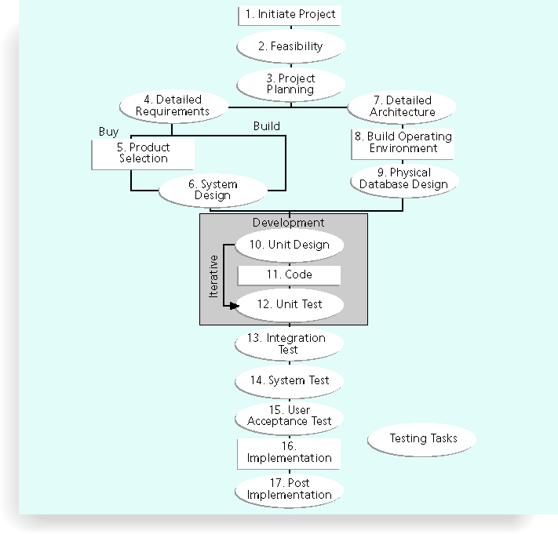

Slide 12
Six Sigma
Six Sigma is “a comprehensive and flexible system for achieving, sustaining, and maximizing business success. Six Sigma is uniquely driven by close understanding of customer needs, disciplined use of facts, data, and statistical analysis, and diligent attention to managing, improving, and reinventing business processes.”
(Pande, et al. 2000)
- The target for perfection is the achievement of no more than 3.4 defects per million opportunities
- The principles can apply to a wide variety of processes
- Six Sigma projects normally follow a five-phase improvement process called DMAIC; Define, Measure, Analyze, Improve & Control

Slide 13
Six Sigma Projects Use Project Management
The training for Six Sigma includes many project management concepts, tools, and techniques
For example, Six Sigma projects often use business cases, project charters, schedules, budgets, and so on
- Six Sigma projects are done in teams; the project manager is often called the team leader, and the sponsor is called the champion

Slide 14
Six Sigma and Statistics
- The term sigma means standard deviation
- Standard deviation measures how much variation exists in a distribution of data
- Standard deviation is a key factor in determining the acceptable number of defective units found in a population
- Six Sigma projects strive for no more than 3.4 defects per million opportunities, yet this number is confusing to many statisticians

Slide 15
Standard Deviation & Normal Distribution
Standard Deviation measures how much variation exists in the distribution of data.
Small standard deviation means clustering around the middle
Large standard deviation means data is spread out and greater level of variability.
Normal Distribution is a bell-shaped curve that is symmetrical regarding the mean or average value of the data being analyzed.
In any normal distribution,
68.3% is within the 1st standard deviation (1σ)
95.5% is within the 2nd standard deviation (2σ)
99.7% is within the 3rd standard deviation (3σ)

Slide 16
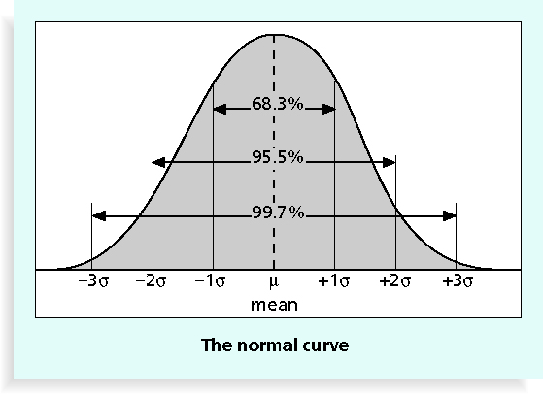
Normal Distribution & Standard Deviation

Slide 17
Six Sigma Uses a Conversion Table
- Using a normal curve, if a process is at six sigma, there would be no more than two defective units per billion produced
- Six Sigma uses a scoring system that accounts for time, an important factor in determining process variations
- Yield represents the number of units handled correctly through the process steps
- A defect is any instance where the product or service fails to meet customer requirements
- There can be several opportunities to have a defect

Slide 18
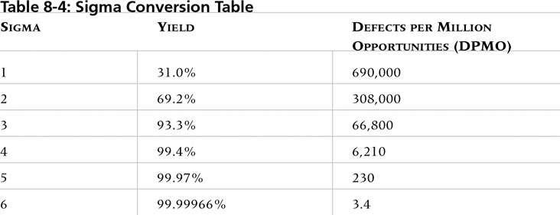
Sigma Conversion Table
Accounts for more variation
Accounts for the definition of a defect, and opportunities rather than pure numbers

Slide 19
Standards and Models
International Organization for Standards (www.iso.org)
ISO Standards for Quality
+ More generic to all types of projects
+ Anecdotal evidence suggests relatively easy to achieve
+ Results in definite quality improvement
‘-’ Standards not available freely
Software Engineering Institute’s CMMI Model (www.sei.cmu.edu/cmmi/)
Capability Maturity Model Integrated
+ Freely available
+ Can implement individual processes to improve quality
- Not easy to obtain a high CMMI level

Slide 20
CMMI - Continued
Originated from software and IT projects, so better suited for the industry.
Can be applicable to different types of projects.
CMMI for Development focuses on 22 process areas across different aspects of a project, known as categories, such as Project Management, Process Management, Engineering and Support.
Can help determine capability or maturity of an organisation, and quality improvement work can be more focussed.

Slide 21

Any Thoughts, Questions, Ideas?

Slide 22
Reading Materials for the Week
Schwalbe, K., 2007. Information Technology Project Management 5th ed., United States of America: Thomson Course Technology. Chapter 9
PMBOK Guide, Chapter 9

Slide 23
Conclusions
Project Quality Management is integral to the successful and satisfactory delivery of any project
Quality should be part of all aspects of a project

Slide 24
References
- Pande, Peter S., Robert P. Neuman, and Roland R. Cavanagh, The
Six Sigma Way, New York: McGraw-Hill, 2000, p. xi
Schwalbe, K., 2007. Information Technology Project Management 5th ed., United States of America: Thomson Course Technology. Chapter 8
PMBOK Guide, Chapter 8

